Slide 1
PERFECT COMPETITION
Dr. Napinder Kaur
Assistant Professor

Slide 2
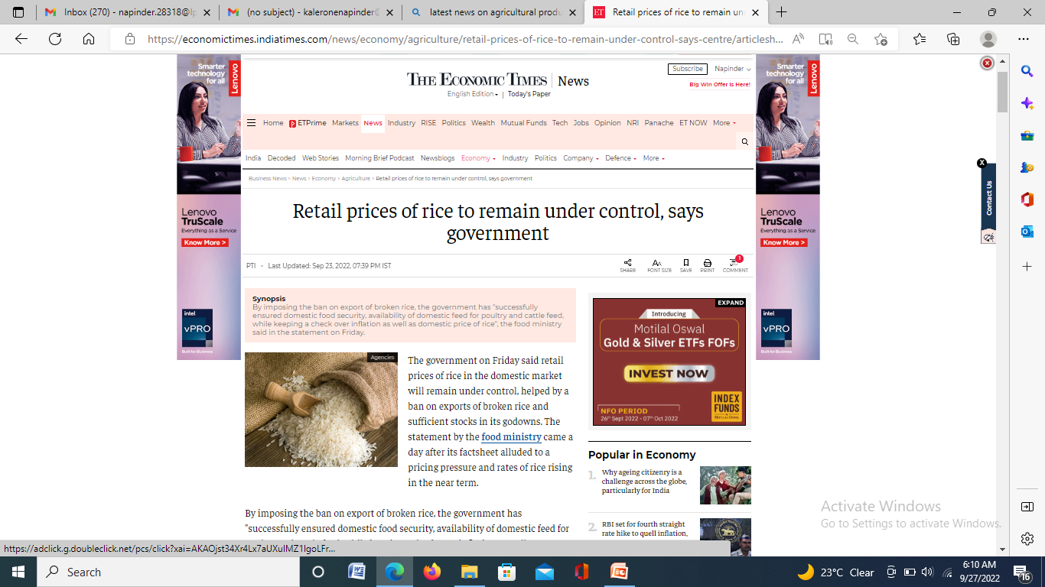
WHAT’S IN THE NEWS?

Slide 3
LEARNING OUTCOMES
After the lecture, you will be able to
Introduce the basics of market morphology
Examine the nature of a perfectly competitive market.

Slide 4
MARKET
Market refers to the interaction between sellers and buyers of a good at a mutually agreed upon price.

Slide 5
MARKET MORPHOLOGY
Nature of competition
Nature of product
Number and size of buyers
Freedom to enter into or exit from the market.

Slide 6
PERFECT COMPETITION
Presence of large number of buyers and sellers.
Homogenous product
Freedom of entry and exit
Perfect knowledge
Perfectly elastic demand curve

Slide 7
…….CONTD.
Perfect mobility of factors of production
No governmental intervention
Firm is a price taker

Slide 8
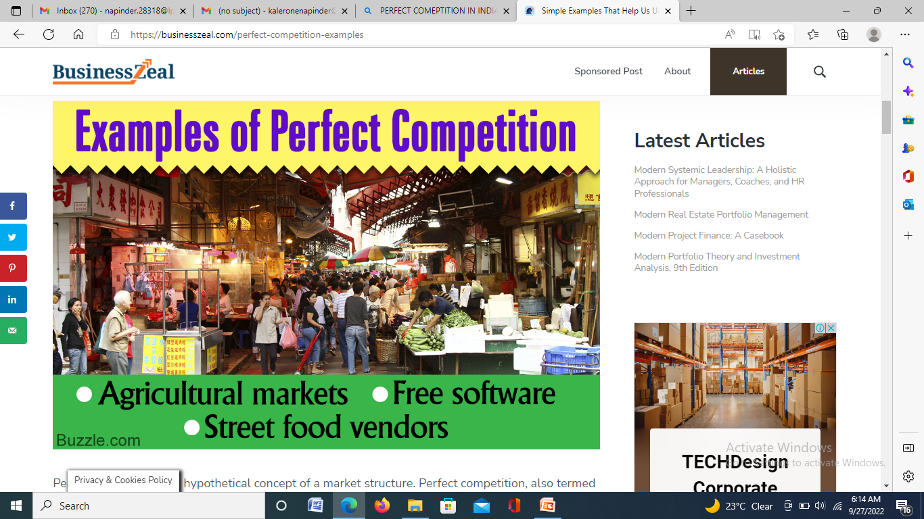
EXAMPLES

Slide 9
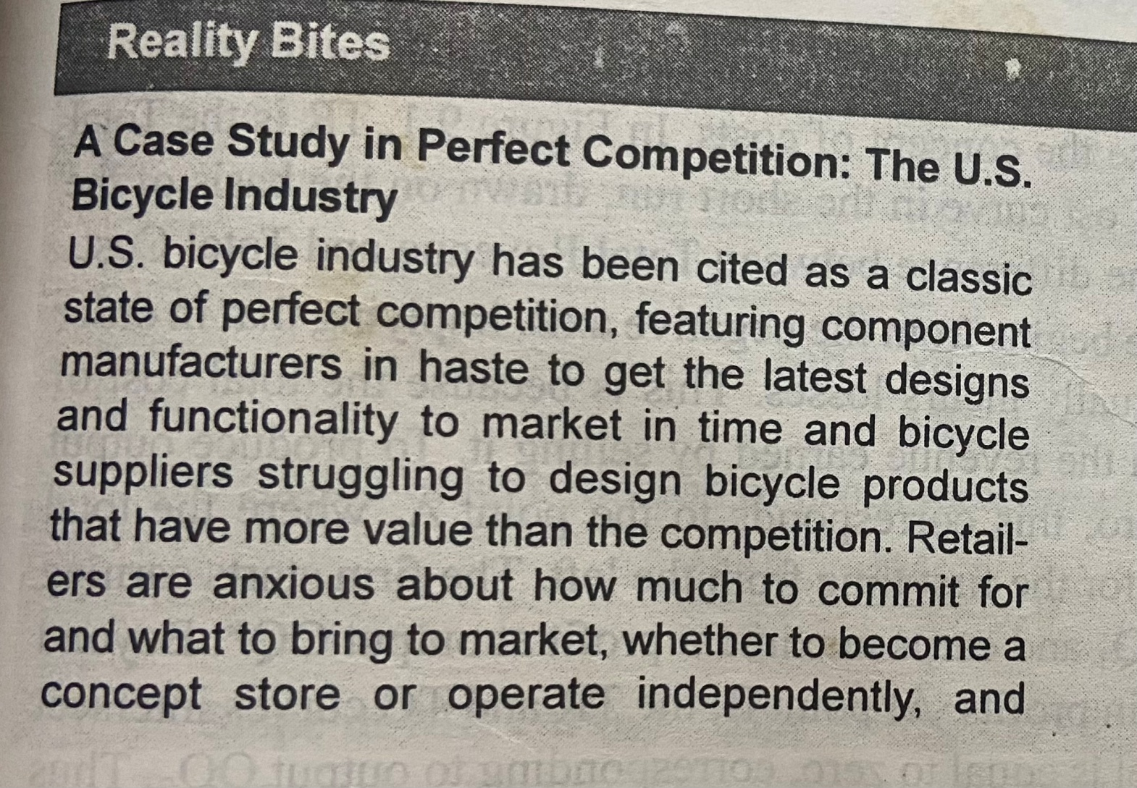
PERFECT COMPETITION

